Slide 1


Slide 2
Introduction
There are many reasons for over voltages and under voltages in power system. The overvoltage causes number of effects in the power system. It may cause insulation failure of the equipments, malfunction of the equipments. Undervoltage occurs when the average voltage of a three-phase power system drops below intended levels, and is sometimes referred to as a brown-out. Electromechanical devices, including three phase motors and pumps, are designed to be operated at very specific voltage levels. If these devices are allowed to operate at reduced voltage levels they will draw higher currents. The increase in current causes increased heat in the winding and coils of the equipment damaging the critical insulation protecting them. Operating in Undervoltage conditions can drastically reduce the life of the electromechanical equipment and lead to premature failure.

Slide 3
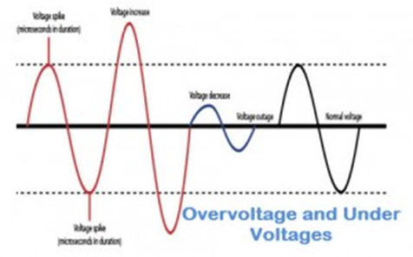
Background
For the satisfactory working of all electrical and electronic devices, it is recommended to allow voltage at prescribed limits. Voltage fluctuations in electric power supply certainly have adverse effects on connected loads. These fluctuations can be of over voltage and under voltages which are caused by several reasons like voltage surges, lightning, overload, etc. Over voltages are the voltages that exceed the normal or rated values which cause insulation damage to electrical appliances leading to short circuits. Similarly, under-voltage causes overloading of the equipment leading to lamp flickers and inefficient performance of the equipment.

Slide 4
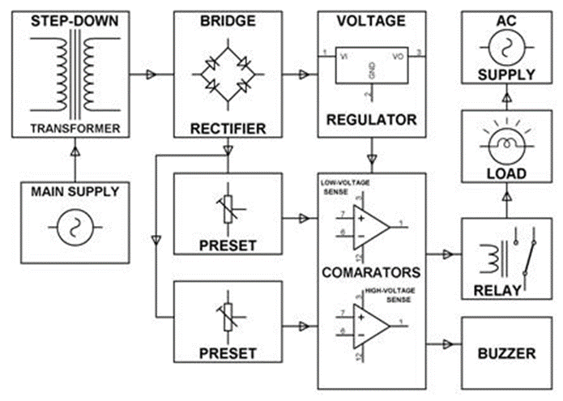
Analysis and design (using comparators)
This voltage protection circuit is designed to develop a low-voltage and high-voltage tripping mechanism to protect a load from any damage. In many of the homes and industries fluctuations in AC mains supply take place frequently. The electronic devices get easily damaged due to fluctuations. To overcome this problem, we can implement a tripping mechanism of under / overvoltage protection circuit to protect the loads from the undue damage.

Slide 5
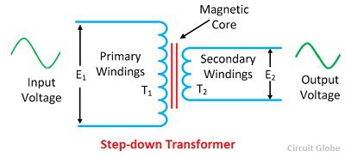
List of components and their uses
A.) Step-down Transformer
A transformer in which the output (secondary) voltage is less than its input (primary) voltage is called a step-down transformer. The number of turns on the primary of the transformer is greater than the turn on the secondary of the transformer, i.e., T₂ < T₁. The step-down transformer is shown in the figure below.
The voltage turn ratio of the step-down transformer is 2:1. The voltage turn ratio determines the magnitude of voltage transforms from primary to secondary windings of the transformer.
Step-down transformer is made up of two or more coil wound on the iron core of the transformer. It works on the principle of magnetic induction between the coils. The voltage applied to the primary of the coil magnetise the iron core which induces the secondary windings of the transformer. Thus the voltage transforms from primary to the secondary winding of the transformer.
Applications – It is used for electrical isolation, in a power distribution network, for controlling the home appliances, in a doorbell, etc.
Specifications: 220V/ 12-0-12 V

Slide 6
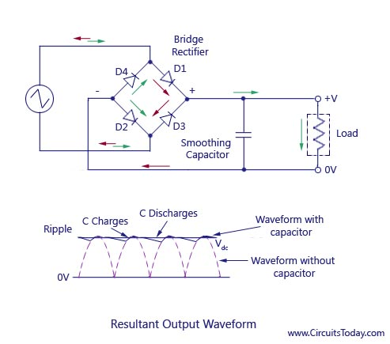
B.) BRIDGE RECTIFIER
This bridge rectifier uses diodes for rectifying the input as shown in the figure. Since the diode is a unidirectional device that allows the current flow in one direction only. With this configuration of diodes in the rectifier, it doesn’t allow the power to vary depending on the load requirement. So this type of rectifier is used
in constant or fixed power supplies.
During the Positive half cycle of the input AC waveform diodes D1 and D2 are forward biased and D3 and D4 are reverse biased. When the voltage, more than the threshold level of the diodes D1 and D2, starts conducting – the load current starts flowing through it, as shown as red lines path in the diagram below.
During the negative half cycle of the input AC waveform, the diodes D3 and D4 are forward biased, and D1 and D2 are reverse biased. Load current starts flowing through the D3 and D4 diodes when these diodes start conducting as shown in the figure.
We can observe that in both the cases, the load current direction is same, i.e., up to down as shown in the figure – so unidirectional, which means DC current. Thus, by the usage of a bridge rectifier, the input AC current is converted into a DC current. The output at the load with this bridge wave rectifier is pulsating in nature, but for producing a pure DC requires additional filter like capacitor.

Slide 7
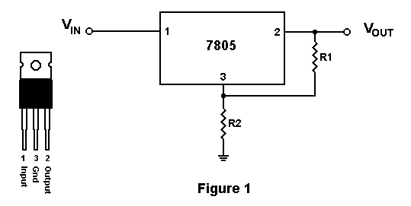
C.) Voltage Regulator
This type of regulator acts as a voltage divider in the circuit and is the kind of regulator commonly used for designing low power and low-cost applications. With the linear regulator, we will be taking advantage of a power transistor (BJT or MOSFET) that plays the role of a variable resistor, raising and lowering the output voltage of your circuit as your input supply changes.
Regardless of what kind of load is placed on the circuit, a linear voltage regulator will always keep pace to provide you with a constant, steady output voltage. For example, a 3-pin linear voltage regulator like the LM7805 provides a consistent, 5 volt 1 amp output so long as the input voltage doesn’t exceed 36 volts.
Specifications: KA-7809

Slide 8
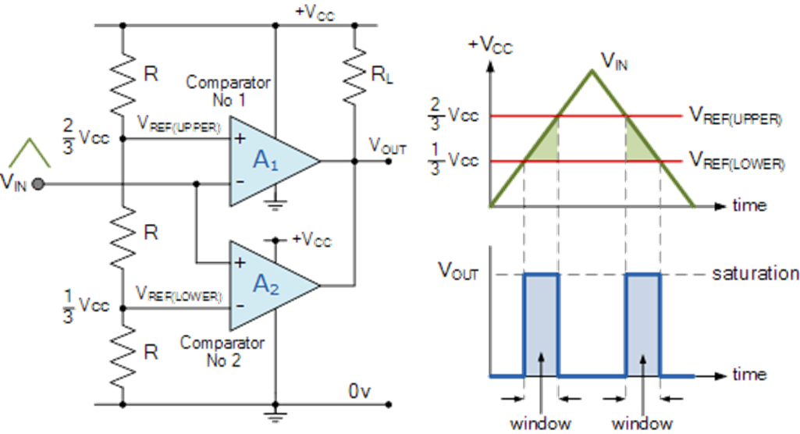
D.) Window comparator
A window detector circuit, also called window comparator circuit or dual edge limit detector circuits is used to determine whether an unknown input is between two precise reference threshold voltages. It employs two comparators to detect over-voltage or under-voltage.
Each single comparator detects the common input voltage against one of two reference voltages, normally upper and lower limits. Outputs behind a logic gate like AND detect the input as in range of the so-called "window" between upper and lower reference.
Window detectors are used in industrial alarms, level sensor and controls, digital computers and production-line testing.
Specifications: LM358 IC

Slide 9
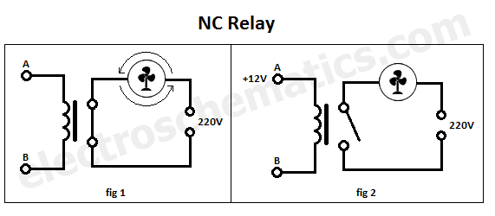
e.) Relay
The NC Normally-Closed SPST (Single Pole Single Throw) relay has an initial closed circuit state when no current is applied to its internal coil therefore it connects the power to the load (fan, light bulb, etc). When voltage is applied to the coil of the relay the internal switch goes to the open position and disconnects the power from the load. It is also called Form B.
In figure 1 no DC voltage is applied to points A and B therefore no current flows through the coil of the relay, the contact stays in the close position and the fan will be switched ON because it is connected to the 220V.
In figure 2 we apply a DC voltage (let’s say 12V) to the coil (points A and B). Now the coil gets energised and it switches the contact to the opened position and the fan will be switched OFF because no current can flow from the 220V.
Specifications: KT-450
5V DC
1A 120 VAC
2A 24 VDC

Slide 10
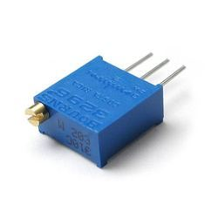
f.) preset
A preset is a three legged electronic component which can be made to offer varying resistance in a circuit. The resistance is varied by adjusting the rotary control over it. The adjustment can be done by using a small screw driver or a similar tool. The resistance does not vary linearly but rather varies in exponential or logarithmic manner. Such variable resistors are commonly used for adjusting sensitivity along with a sensor.
The variable resistance is obtained across the single terminal at front and one of the two other terminals. The two legs at back offer fixed resistance which is divided by the front leg. So whenever only the back terminals are used, a preset acts as a fixed resistor. Presets are specified by their fixed value resistance.
Specifications: 0-11 ohm

Slide 11
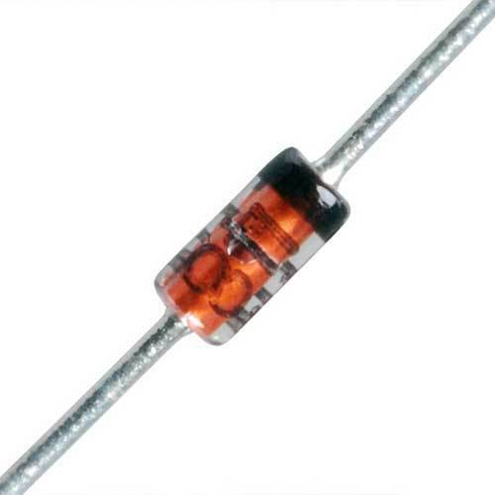
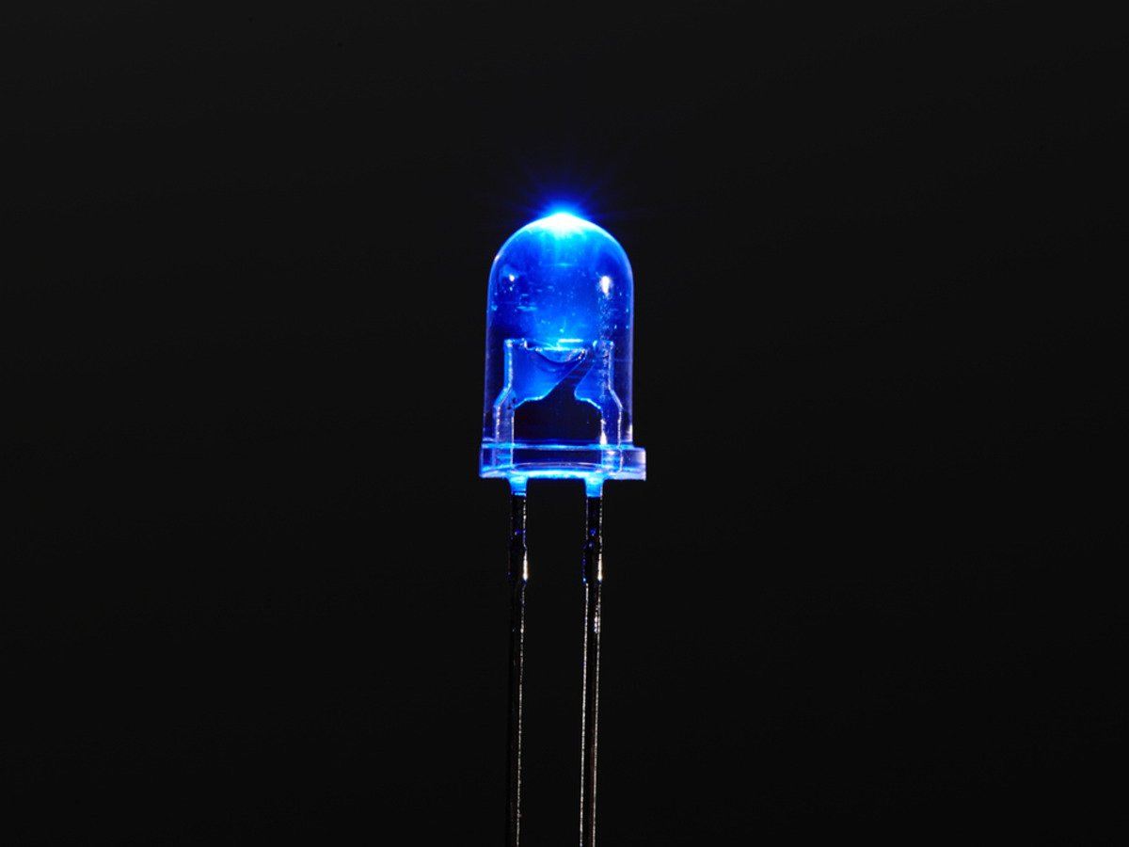
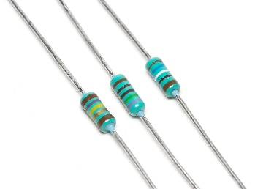
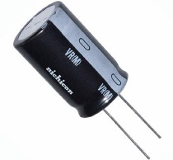
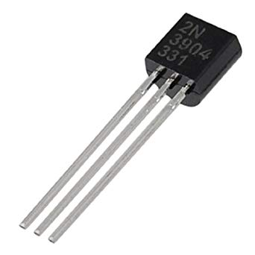
g.) Zener Diode
Acts as a voltage regulator.
Specifications: KA7809 (9 V)
h.) LED
acts as indicator
i.) Resistances
10k ohm,41k ohm,1k ohm (with 5% tolerance)
j.) Capacitors
470 micro F, 25 V
0.1 micro F, 25 V
k.) Transistor
N-P-N transistor (BC547)

Slide 12
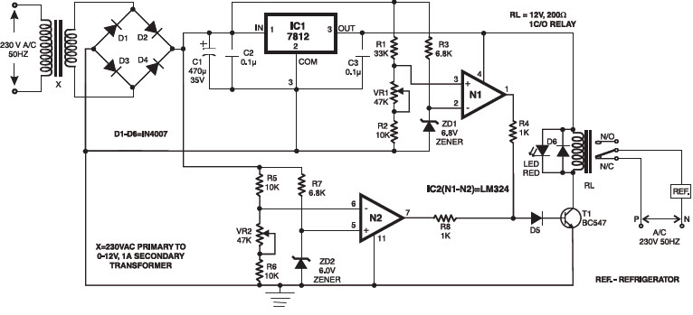
implementation
Here we implement the circuit using comparators & the other elements.

Slide 13
Working of the circuit
As shown in the above block diagram, the mains AC power supplies the power to the whole circuit and for operating loads by using relays, and also for tripping the load (lamps) in the presence of the input voltage which falls above or below a set value.
Two comparators used as a window comparator formed out of one quad comparator IC. This operation delivers an error in the output if the input voltage to the comparator crosses the limit beyond the voltage window.
In this circuit, an unregulated power supply is connected to both op-amps terminals, wherein each non-inverting terminal is connected through the two series resistors and a potentiometer arrangement. Similarly, the inverting terminal is also powered through Zener diode and resistance arrangements, as shown in the given under or overvoltage protection circuit.
The Potentiometer’s preset VR1 is adjusted such that the voltage at non-inverting is less than 6.8V for stable maintenance of load for the normal supply range of 180V-240V and the voltage of inverting terminal is 6.8V constant due to Zener diode.
Hence the op-amp output is zero under this range and thus the relay coil is de-energized and the load is not interrupted during this stable operation.
When the voltage is beyond the 240 V the voltage at the non-inverting terminal is more than 6.8, so the operational amplifier output goes high. This output drives the transistor and thus the relay coil gets energized and finally loads are turned off due to overvoltage.
Similarly, for under voltage protection, lower comparator energizes the relay when the supply voltage falls below 180 V by maintaining 6V at the inverting terminal. These under and overvoltage settings can be changed by varying the respective potentiometers.

Slide 14
Advantages:
We can use this circuit to protect voltage sensitive devices from high and low voltages to ensure proper working of the devices.
This device is not very expensive.
The similar model can be used for mains supply to provide only a range of voltages to the house else no supply.
The range of voltage, in which the switch is needed to ON can be changed by changing the voltage divider resistances.
Disadvantages:
Due to noise the circuit operation will not be proper.
For providing the constant voltage input to the terminal of comparator we have used zener diodes, which is not purely constant.
The circuit works on the supply voltage of AC source. If it is too low than circuit will not work because different elements of the circuit needs a minimum voltage to operate.
To remove multiple switching due to noise, we need to implement hysteresis comparator by providing feedback to the comparator.

Slide 15
Conclusion
It has been a very valuable experience working with the team for the project. We have devised a very simple model for the under and overvolt protection but we expect it to work in other circumstances just by small modifications in the comparators. Although we have not trained it much to variable circumstances we are quite pleased that the protection principle is working well and good in our real time environment.

Slide 16
References
a.) Integrated Electronics – Millman Halkias
b.) Op-Amps and Linear Integrated Circuits- Ramakanth A. Gaikwad
c.) Wikipedia Circuit Breakers.

Slide 17
THANK YOU!!!

